Slide 1
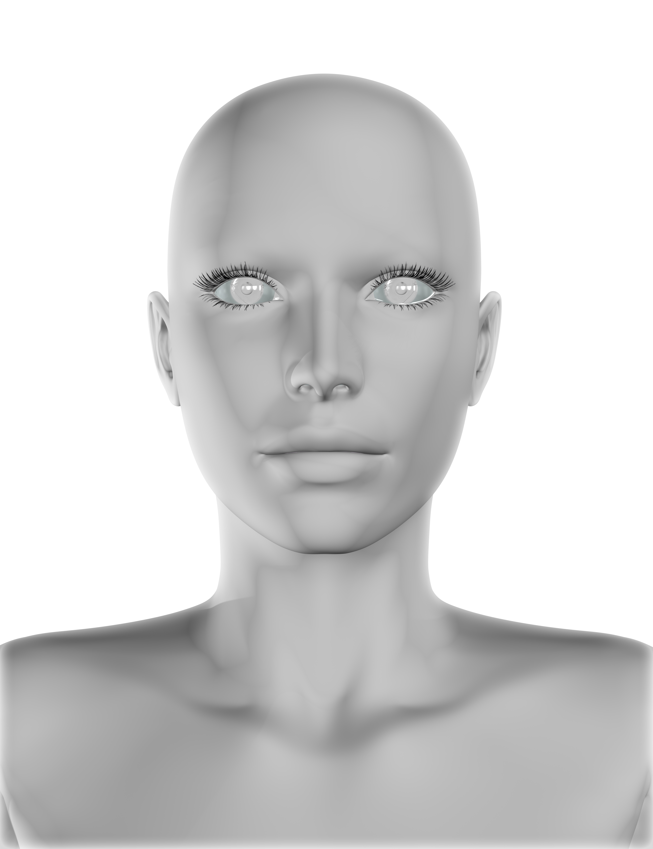
Artsy
Makeup by SO-101 robotic arm

Slide 2
Problem statement
Makeup routines can be tasking, especially when they are being performed daily. They are time-consuming and might also produce wrong results if not done properly. In addition, some are complex and require a high level of concentration and precision.

Slide 3
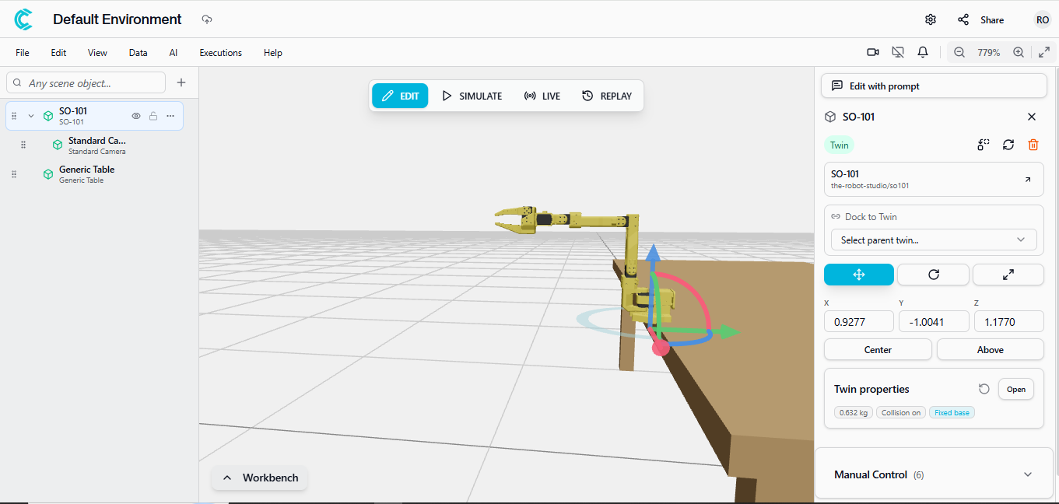
Solution
The SO-101 robotic arm comes in handy since it can be able to pick makeup items e.g lipstick or brush and perform a wide range of movements at different angles to apply the makeup as instructed by the user. Furthermore, it can be operated via voice commands through the cyberwave python SDK, making it very user-friendly for this particular use case.
Through the Physical AI infrastructure that it operates on, it is able to do the work with a high level of precision can be relied upon to produce quality results.

Slide 4
How it works
The user can operate the robot via a Graphical User Interface (web app) or through the terminal. For the web app, the user can upload a face image then specify parameters such as brush size, type of makeup, and color. Once they click the “apply makeup” button they will be able to see the robot make the movements in the Cyberwave simulation environment while also seeing the makeup being applied in real-time on the image uploaded on the web app.
For the terminal, the user can type the text commands or speak the voice commands. The result is the same as when using the web app.

Slide 5
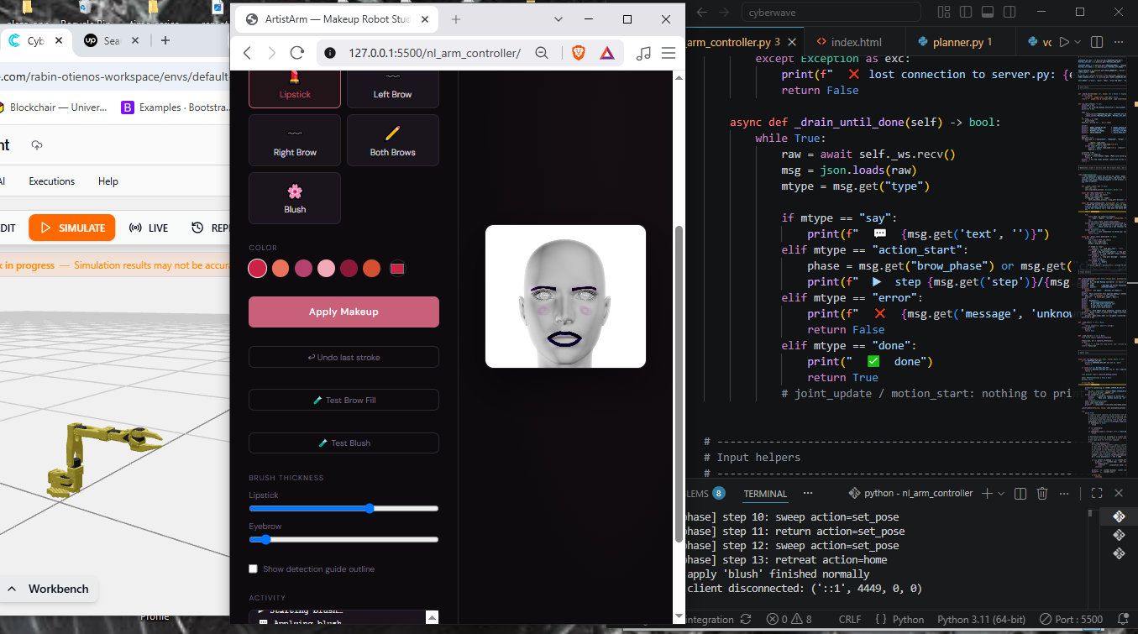

Slide 6
Tech stack
Cyberwave Python SDK – for connecting to the SO-101 robot and controlling it.
Mistral Voxtral – for translating voice commands to text.
Deepseek LLM – for creating an action plan based on the textual commands.
HTML/JS – for the web interface used for visual user interaction and visualizing makeup application.
MediaPipe FaceMesh – library for detecting facial features on the uploaded image.

Slide 7
Documentation
Github repo: https://github.com/Rabinnnn/artsy.git
Blog post: https://dev.to/otienorabin/i-taught-a-robotic-arm-to-do-makeup-sort-of-3glh
Demo video: https://youtu.be/no4gzyEJzLA

